Slide 1

UNIT-I
19.<number>
Copyright © The McGraw-Hill Companies, Inc. Permission required for reproduction or display.

Slide 2
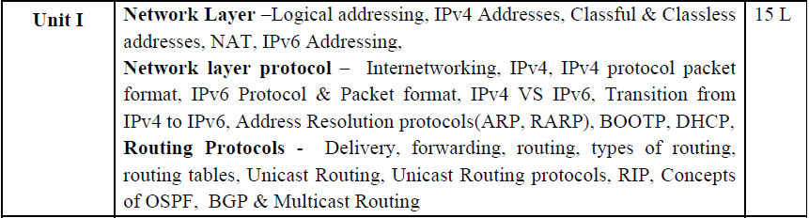
19.<number>

Slide 3
Chapters for Unit 1
Data Communication & Networking (Forouzan) , Tata McGraw-Hill Education
chapter 19 Network Layer: Logical Addressing
chapter 20 Network Layer: Internet Protocol
chapter 21 network Layer: Address Mapping
chapter 22 Network Layer: Delivery, Forwarding, and Routing
19.<number>

Slide 4
Chapter 22
Network Layer:
Delivery, Forwarding, and Routing
19.<number>
Copyright © The McGraw-Hill Companies, Inc. Permission required for reproduction or display.

Slide 5
OBJECTIVES
This chapter describes the delivery, forwarding, and routing of IP packets to their final destinations.
Delivery refers to the way a packet is handled by the underlying networks under the control of the network layer.
Forwarding refers to the way a packet is delivered to the next station.
Routing refers to the way routing tables are created to help in forwarding.
Routing protocols are used to continuously update the routing tables that are consulted for forwarding and routing.
In this chapter, we also briefly discuss common unicast and multicast routing protocols.

Slide 6

22-1 DELIVERY
The network layer supervises the handling of the packets by the underlying physical networks.
We define this handling as the delivery of a packet.

Slide 7
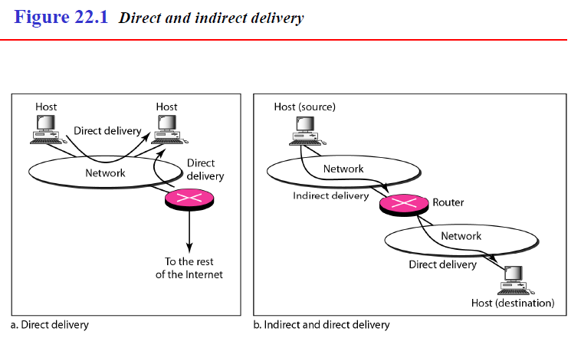
Direct Versus Indirect Delivery
The delivery of a packet to its final destination is accomplished by using two different methods of delivery, direct and indirect, as shown in Figure 22.1.

Slide 8
Direct Delivery
In a direct delivery, the final destination of the packet is a host connected to the same physical network as the deliverer.
Direct delivery occurs when the source and destination of the packet are located on the same physical network or when the delivery is between the last router and the destination host.
The sender can easily determine if the delivery is direct.
It can extract the network address of the destination (using the mask) and compare this address with the addresses of the networks to which it is connected.
If a match is found, the delivery is direct.

Slide 9
Indirect Delivery
If the destination host is not on the same network as the deliverer, the packet is delivered indirectly.
In an indirect delivery, the packet goes from router to router until it reaches the one connected to the same physical network as its final destination.
Note that a delivery always involves one direct delivery but zero or more indirect deliveries.
Note also that the last delivery is always a direct delivery.

Slide 10
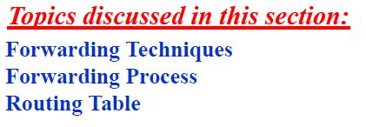
22.2 FORWARDING
Forwarding means to place the packet in its route to its destination.
Forwarding requires a host or a router to have a routing table.
When a host has a packet to send or when a router has received a packet to be forwarded, it looks at this table to find the route to the final destination.
However, this simple solution is impossible today in an internetwork such as the Internet because the number of entries needed in the routing table would make table lookups inefficient.

Slide 11
Forwarding Techniques
Several techniques can make the size of the routing table manageable and also handle issues such as security.
We briefly discuss these methods here.
1. Next-Hop Method Versus Route Method
2. Network-Specific Method Versus Host-Specific Method
3. Default Method

Slide 12
1.Next-Hop Method Versus Route Method
One technique to reduce the contents of a routing table is called the next-hop method.
In this technique, the routing table holds only the address of the next hop instead of information about the complete route (route method).
The entries of a routing table must be consistent with one another.
Figure 22.2 shows how routing tables can be simplified by using this technique.

Slide 13
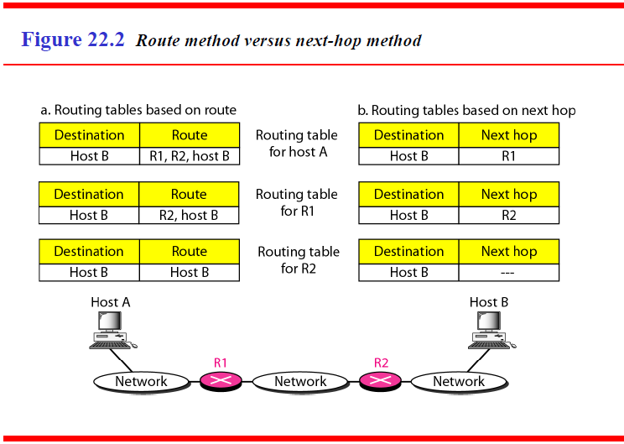
19.<number>

Slide 14
2.Network-Specific Method Versus Host-Specific Method
A second technique to reduce the routing table and simplify the searching process is called the network-specific method.
Here, instead of having an entry for every destination host connected to the same physical network (host-specific method), we have only one entry that defines the address of the destination network itself.
In other words, we treat all hosts connected to the same network as one single entity.
For example, if 1000 hosts are attached to the same network, only one entry exists in the routing table instead of 1000.
Figure 22.3 shows the concept.
Host-specific routing is used for purposes such as checking the route or providing
security measures.

Slide 15
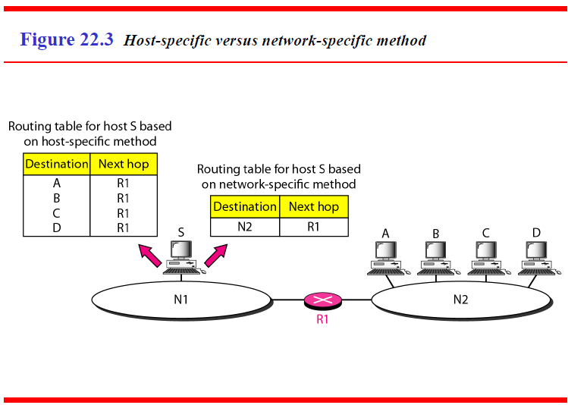
19.<number>

Slide 16
3. Default Method
Another technique to simplify routing is called the default method.
In Figure 22.4 host A is connected to a network with two routers. Router R1 routes the packets to hosts connected to network N2.
However, for the rest of the Internet, router R2 is used.
So instead of listing all networks in the entire Internet, host A can just have one entry called the default (normally defined as network address 0.0.0.0).

Slide 17
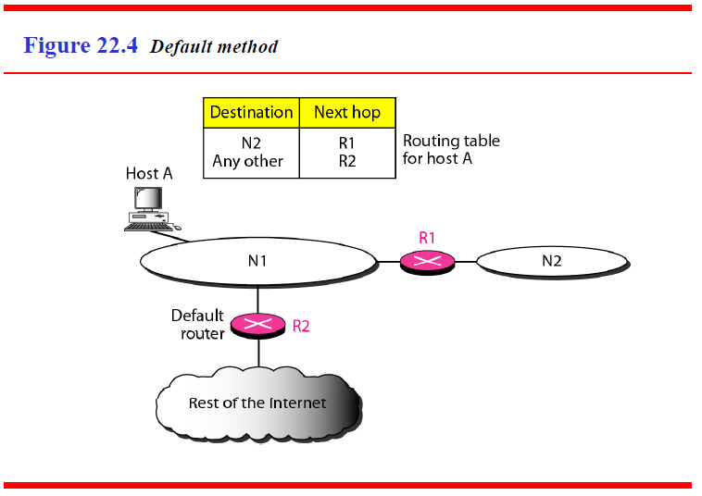
19.<number>

Slide 18
Forwarding Process
We assume that hosts and routers use classless addressing because classful addressing can be treated as a special case of classless addressing.
In classless addressing, the routing table needs to have one row of information
for each block involved.
The table needs to be searched based on the network address (first address in the block).
Unfortunately, the destination address in the packet gives no clue about the network address.
To solve the problem, we need to include the mask (/n) in the table; we need to have an extra column that includes the mask for the corresponding block.
Figure 22.5 shows a simple forwarding module for classless addressing.

Slide 19
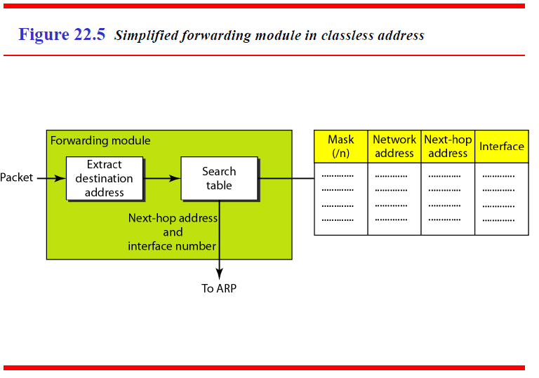
19.<number>

Slide 20
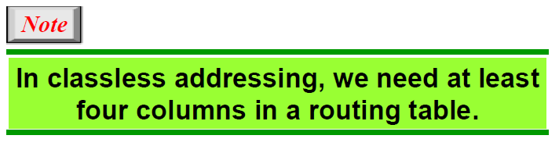
19.<number>

Slide 21
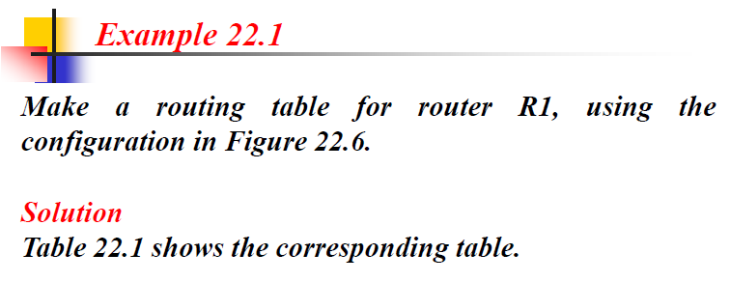
19.<number>

Slide 22
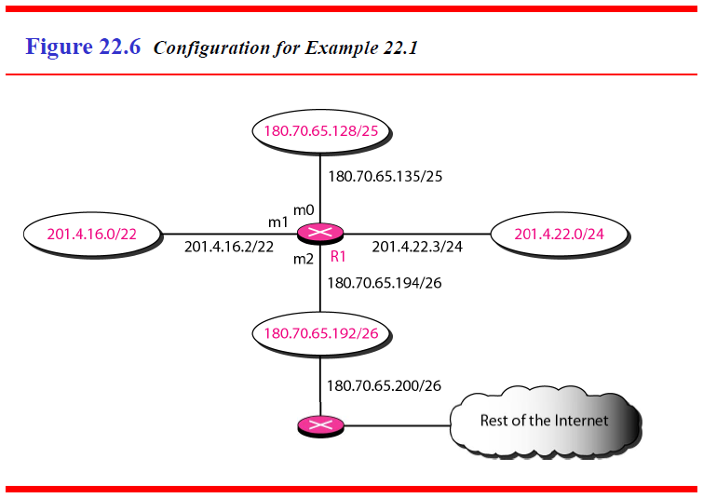
19.<number>

Slide 23
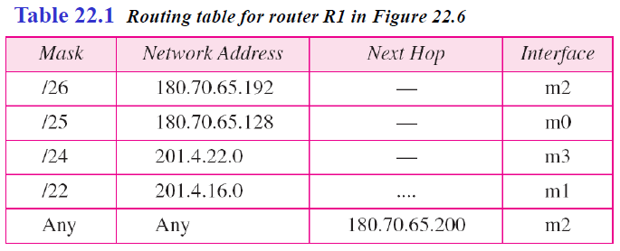
19.<number>

Slide 24
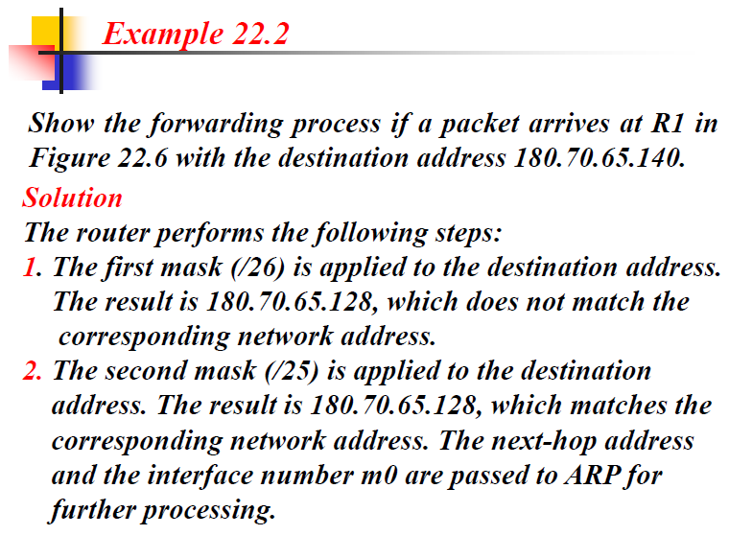
19.<number>

Slide 25
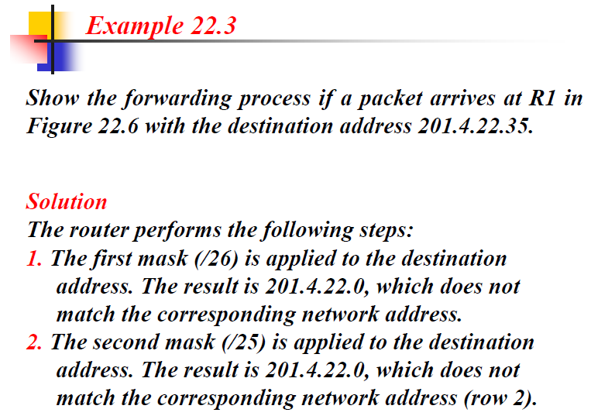
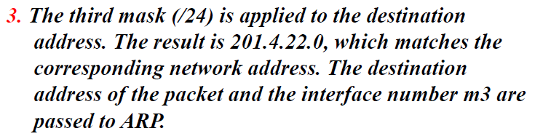
19.<number>

Slide 26
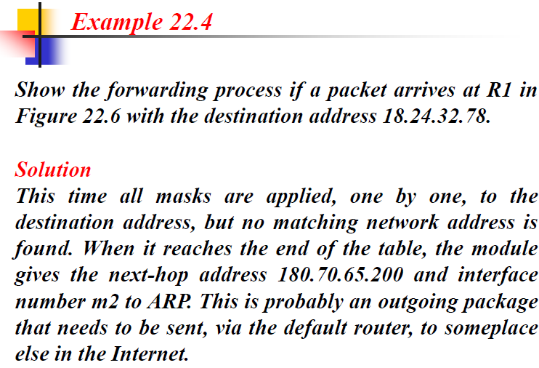
19.<number>

Slide 27
Address Aggregation
When we use classless addressing, it is likely that the number of routing table entries will increase.
This is so because the intent of classless addressing is to divide up the
whole address space into manageable blocks.
The increased size of the table results in an increase in the amount of time needed to search the table.
To alleviate the problem, the idea of address aggregation was designed.

Slide 28
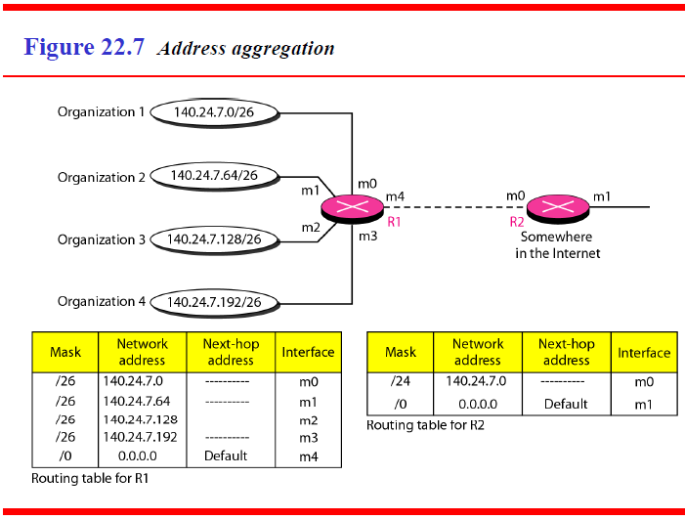
In Figure 22.7 we have two routers.
19.<number>

Slide 29
Router R1 is connected to networks of four organizations that each use 64 addresses.
Router R2 is somewhere far from R1.
Router R1 has a longer routing table because each packet must be correctly routed to the appropriate organization.
Router R2, on the other hand, can have a very small routing table.
For R2, any packet with destination 140.24.7.0 to 140.24.7.255 is sent out from interface m0 regardless of the organization number.
This is called address aggregation because the blocks of addresses for four organizations are aggregated into one larger block.
Router R2 would have a longer routing table if each organization had addresses that could not be aggregated into one block.
Note that although the idea of address aggregation is similar to the idea of subnetting, we do not have a common site here; the network for each organization is independent.
In addition, we can have several levels of aggregation.
19.<number>

Slide 30
Longest Mask Matching
What happens if one of the organizations in Figure 22.7 is not geographically close to the other three?
For example, if organization 4 cannot be connected to router R1 for some reason, can we still use the idea of address aggregation and still assign block 140.24.7.192/26 to organization 4?

Slide 31
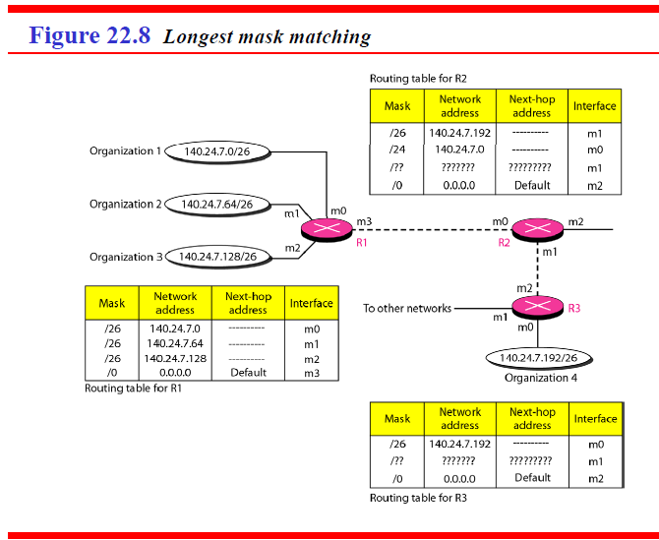
19.<number>

Slide 32
The answer is yes because routing in classless addressing uses another principle, longest mask matching.
This principle states that the routing table is sorted from the longest mask to the shortest mask.
In other words, if there are three masks /27, /26, and /24, the mask /27 must be the first entry and /24 must be last.
Let us see if this principle solves the situation in which organization 4 is separated from the other three organizations.
Figure 22.8 shows the situation.
Suppose a packet arrives for organization 4 with destination address 140.24.7.200.
The first mask at router R2 is applied, which gives the network address 140.24.7.192.
The packet is routed correctly from interface m1 and reaches organization 4.
If, however, the routing table was not stored with the longest prefix first, applying the /24 mask would result in the incorrect routing of the packet to router R1.
19.<number>

Slide 33
Hierarchical Routing
To solve the problem of gigantic (huge) routing tables, we can create a sense of hierarchy in the routing tables.
We said that the Internet is divided into international and national ISPs.
National ISPs are divided into regional ISPs, and regional ISPs are divided into local ISPs.
If the routing table has a sense of hierarchy like the Internet architecture, the routing table can decrease in size.
Let us take the case of a local ISP. A local ISP can be assigned a single, but large
block of addresses with a certain prefix length.
The local ISP can divide this block into smaller blocks of different sizes and can assign these to individual users and organizations, both large and small.
If the block assigned to the local ISP starts with a.b.c.d/n, the ISP can create blocks starting with e.f.g.h/m, where m may vary for each customer and is greater than n.

Slide 34
How does this reduce the size of the routing table?
The rest of the Internet does not have to be aware of this division.
All customers of the local ISP are defined as a.b.c.d/n to the rest of the Internet.
Every packet destined for one of the addresses in this large block is routed to the local ISP.
There is only one entry in every router in the world for all these customers.
They all belong to the same group.
Of course, inside the local ISP, the router must recognize the subblocks and route the packet to the destined customer.
If one of the customers is a large organization, it also can create another level of hierarchy by subnetting and dividing its subblock into smaller subblocks (or sub-subblocks).
In classless routing, the levels of hierarchy are unlimited so long as we follow the rules of classless addressing.
19.<number>

Slide 35
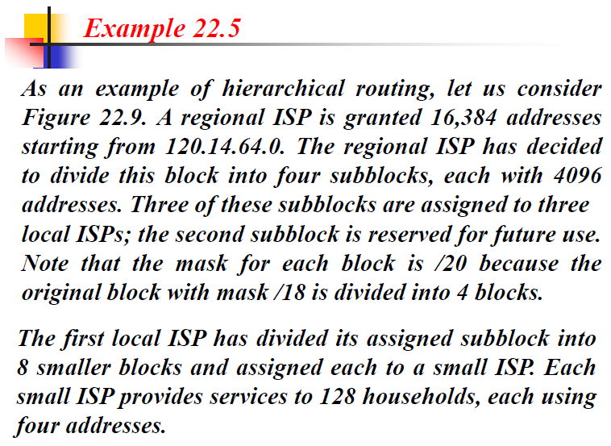
19.<number>

Slide 36
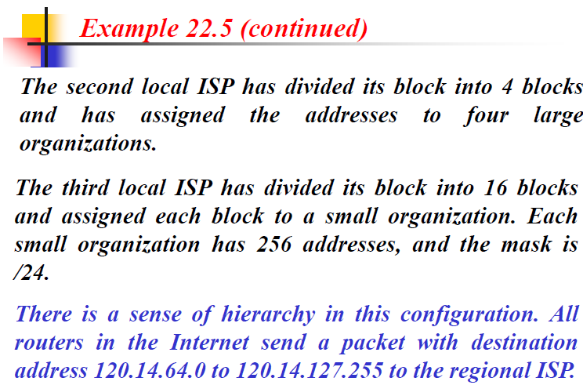
19.<number>

Slide 37
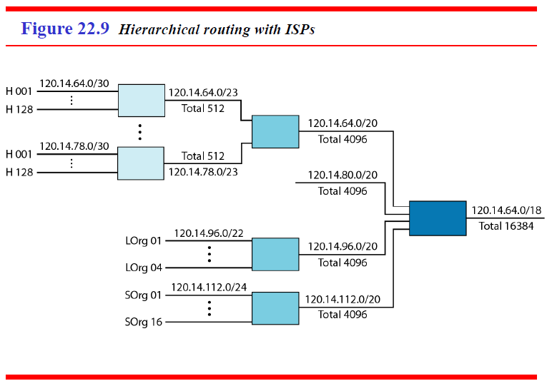
19.<number>

Slide 38
Geographical Routing
To decrease the size of the routing table even further, we need to extend hierarchical routing to include geographical routing.
We must divide the entire address space into a few large blocks.
We assign a block to North America, a block to Europe, a block to Asia, a block to Africa, and so on.
The routers of ISPs outside Europe will have only one entry for packets to Europe in their routing tables.
The routers of ISPs outside North America will have only one entry for packets to North America in their routing tables. And so on.

Slide 39
Routing Table
A host or a router has a routing table with an entry for each destination, or a combination of destinations, to route IP packets.
The routing table can be either static or dynamic.

Slide 40
1. Static Routing Table
A static routing table contains information entered manually.
The administrator enters the route for each destination into the table.
When a table is created, it cannot update automatically when there is a change in the Internet.
The table must be manually altered by the administrator.
A static routing table can be used in a small internet that does not change very often, or in an experimental internet for troubleshooting.
It is poor strategy to use a static routing table in a big internet such as the Internet.

Slide 41
2. Dynamic Routing Table
A dynamic routing table is updated periodically by using one of the dynamic routing protocols such as RIP, OSPF, or BGP.
Whenever there is a change in the Internet, such as a shutdown of a router or breaking of a link, the dynamic routing protocols update all the tables in the routers (and eventually in the host) automatically.
The routers in a big internet such as the Internet need to be updated dynamically for efficient delivery of the IP packets.

Slide 42
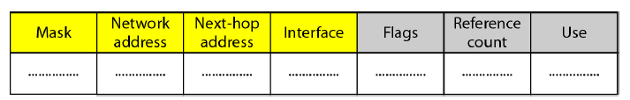
Format
As mentioned previously, a routing table for classless addressing has a minimum of
four columns.
However, some of today's routers have even more columns.
We should be aware that the number of columns is vendor-dependent, and not all columns can be found in all routers.
Figure 22.10 shows some common fields in today's routers.

Slide 43
Some common fields in today's routers.
Mask. This field defines the mask applied for the entry.
2. Network address. This field defines the network address to which the packet is finally delivered.
In the case of host-specific routing, this field defines the address of the destination host.
3. Next-hop address. This field defines the address of the next-hop router to which the packet is delivered.
4. Interface. This field shows the name of the interface.
19.<number>

Slide 44
5. Flags. This field defines up to five flags. Flags are on/off switches that signify
either presence or absence. The five flags are U (up), G (gateway), H (host-specific), D (added by redirection), and M (modified by redirection).
U (up). The U flag indicates the router is up and running. If this flag is not present, it means that the router is down. The packet cannot be forwarded and is discarded.
b. G (gateway). The G flag means that the destination is in another network. The packet is delivered to the next-hop router for delivery (indirect delivery). When this flag is missing, it means the destination is in this network (direct delivery).
c. H (host-specific). The H flag indicates that the entry in the network address
field is a host-specific address. When it is missing, it means that the address is
only the network address of the destination.
d. D (added by redirection). The D flag indicates that routing information for this destination has been added to the host routing table by a redirection message from ICMP.
e. M (modified by redirection). The M flag indicates that the routing information
for this destination has been modified by a redirection message from ICMP.

Slide 45
6. Reference count. This field gives the number of users of this route at the moment.
For example, if five people at the same time are connecting to the same host from this router, the value of this column is 5.
7. Use. This field shows the number of packets transmitted through this router for the corresponding destination.
19.<number>

Slide 46
22.3 UNICAST ROUTING PROTOCOLS
A routing table can be either static or dynamic.
A static table is one with manual entries.
A dynamic table, on the other hand, is one that is updated automatically when there is a change somewhere in the internet.
Today, an internet needs dynamic routing tables.
The tables need to be updated as soon as there is a change in the internet.
For instance, they need to be updated when a router is down, and they need to be updated whenever a better route has been found.
Routing protocols have been created in response to the demand for dynamic routing tables.

Slide 47
A routing protocol is a combination of rules and procedures that lets routers in the internet inform each other of changes.
It allows routers to share whatever they know about the internet or their neighborhood.
The sharing of information allows a router in San Francisco to know about the failure of a network in Texas.
The routing protocols also include procedures for combining information received from other routers.
19.<number>

Slide 48
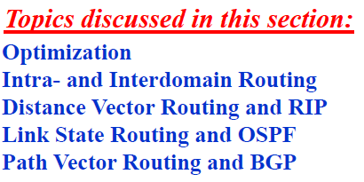
19.<number>

Slide 49
Optimization
A router receives a packet from a network and passes it to another network.
A router is usually attached to several networks.
When it receives a packet, to which network should it pass the packet?
The decision is based on optimization: Which of the available pathways is the optimum pathway? What is the definition of the term optimum?
One approach is to assign a cost for passing through a network.
We call this cost a metric.
However, the metric assigned to each network depends on the type of protocol.
Some simple protocols, such as the Routing Information Protocol (RIP), treat all
networks as equals.
The cost of passing through a network is the same; it is one hop count. So if a packet passes through 10 networks to reach the destination, the total cost is 10 hop counts.

Slide 50
Other protocols, such as Open Shortest Path First (OSPF), allow the administrator to assign a cost for passing through a network based on the type of service required.
A route through a network can have different costs (metrics).
For example, if maximum throughput is the desired type of service, a satellite link has a lower metric than a fiber-optic line.
On the other hand, if minimum delay is the desired type of service, a fiber-optic line has a lower metric than a satellite link.
Routers use routing tables to help decide the best route.
OSPF protocol allows each router to have several routing tables based on the
required type of service.
Other protocols define the metric in a totally different way.
In the Border Gateway Protocol (BGP), the criterion is the policy, which can be set by the administrator.
The policy defines what paths should be chosen.
19.<number>

Slide 51
Intra- and Interdomain Routing
Today, an internet can be so large that one routing protocol cannot handle the task of updating the routing tables of all routers.
For this reason, an internet is divided into autonomous systems.
An autonomous system (AS) is a group of networks and routers under the authority of a single administration.
Routing inside an autonomous system is referred to as intradomain routing.
Routing between autonomous systems is referred to as interdomain routing.
Each autonomous system can choose one or more intradomain routing protocols to handle routing inside the autonomous system.
However, only one interdomain routing protocol handles routing between autonomous systems (see Figure 22.12).

Slide 52
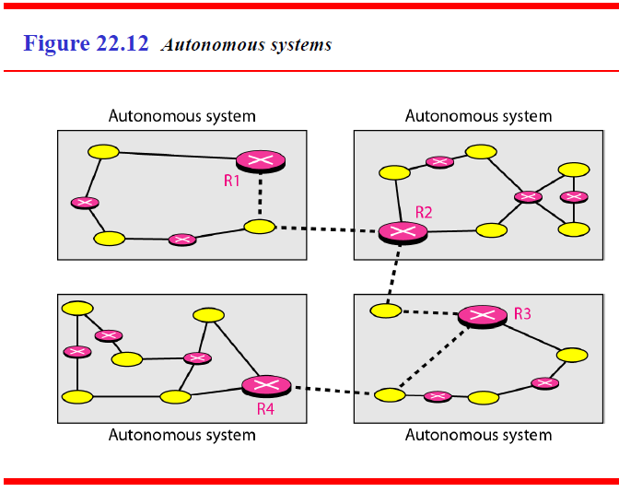
19.<number>

Slide 53

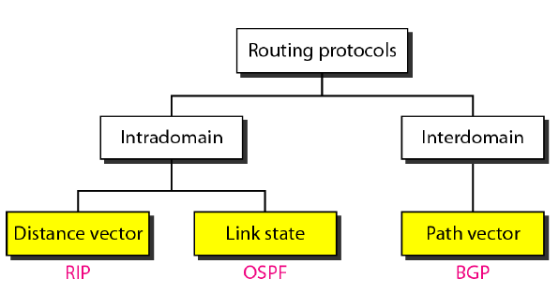
Routing Information Protocol (RIP) is an implementation of the distance vector protocol.
Open Shortest Path First (OSPF) is an implementation of the link state protocol.
Border Gateway Protocol (BGP) is an implementation of the path vector protocol.
19.<number>

Slide 54
1. Distance Vector Routing
In distance vector routing, the least-cost route between any two nodes is the route
with minimum distance.
In this protocol, as the name implies, each node maintains a vector (table) of minimum distances to every node.
The table at each node also guides the packets to the desired node by showing the next stop in the route (next-hop routing).
We can think of nodes as the cities in an area and the lines as the roads connecting
them.
A table can show a tourist the minimum distance between cities.
In Figure 22.14, we show a system of five nodes with their corresponding tables.
The table for node A shows how we can reach any node from this node.
For example, our least cost to reach node E is 6. The route passes through C.

Slide 55
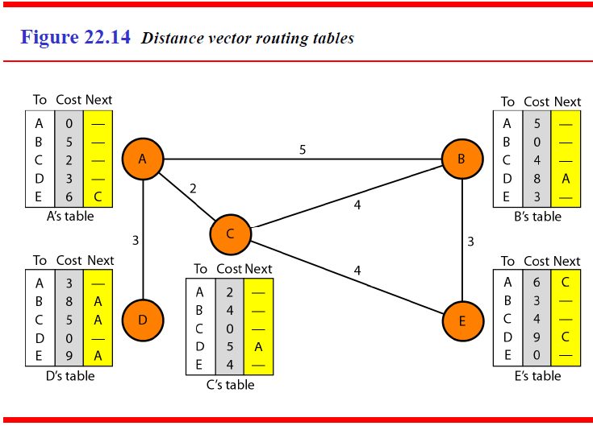
19.<number>

Slide 56
Initialization
The tables in Figure 22.14 are stable; each node knows how to reach any other node and the cost.
At the beginning, however, this is not the case.
Each node can know only the distance between itself and its immediate neighbors, those directly connected to it.
So for the moment, we assume that each node can send a message to the immediate neighbors and find the distance between itself and these neighbors.
Figure 22.15 shows the initial tables for each node.
The distance for any entry that is not a neighbor is marked as infinite (unreachable).

Slide 57
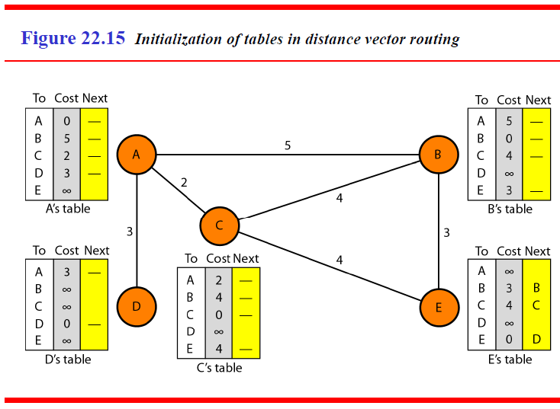
19.<number>

Slide 58
Sharing
The whole idea of distance vector routing is the sharing of information between neighbors.
Although node A does not know about node E, node C does. So if node C shares
its routing table with A, node A can also know how to reach node E.
On the other hand, node C does not know how to reach node D, but node A does. If node A shares its routing table with node C, node C also knows how to reach node D.
In other words, nodes A and C, as immediate neighbors, can improve their routing tables if they help each other.
There is only one problem. How much of the table must be shared with each neighbor?
A node is not aware of a neighbor's table. The best solution for each node is to send its entire table to the neighbor and let the neighbor decide what part to use and what part to discard.

Slide 59
However, the third column of a table (next stop) is not useful for the neighbor.
When the neighbor receives a table, this column needs to be replaced with the sender's name.
If any of the rows can be used, the next node is the sender of the table.
A node therefore can send only the first two columns of its table to any neighbor.
In other words, sharing here means sharing only the first two columns.
19.<number>

Slide 60
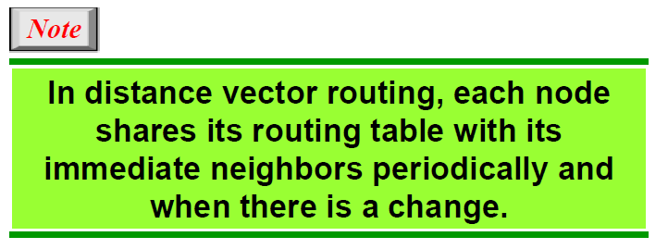
19.<number>

Slide 61
Updating
When a node receives a two-column table from a neighbor, it needs to update its routing table. Updating takes three steps:
1. The receiving node needs to add the cost between itself and the sending node to each value in the second column. The logic is clear. If node C claims that its distance to a destination is x mi, and the distance between A and C is y mi, then the distance between A and that destination, via C, is x + y mi.
2. The receiving node needs to add the name of the sending node to each row as the third column if the receiving node uses information from any row. The sending node is the next node in the route.

Slide 62
3. The receiving node needs to compare each row of its old table with the corresponding row of the modified version of the received table.
a. If the next-node entry is different, the receiving node chooses the row with the smaller cost. If there is a tie, the old one is kept.
b. If the next-node entry is the same, the receiving node chooses the new row. For example, suppose node C has previously advertised a route to node X with distance 3. Suppose that now there is no path between C and X; node C now advertises this route with a distance of infinity. Node A must not ignore this value even though its old entry is smaller. The old route does not exist any more. The new route has a distance of infinity.
19.<number>

Slide 63
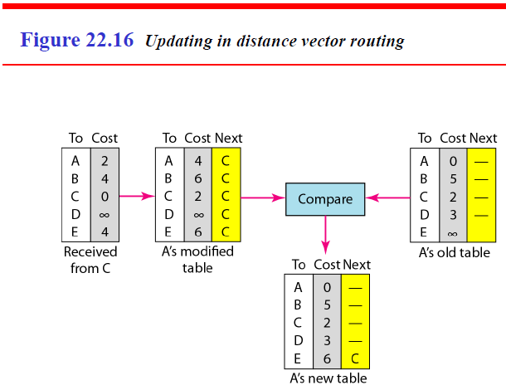
Figure 22.16 shows how node A updates its routing table after receiving the partial table from node C.
19.<number>

Slide 64
There are several points we need to emphasize here.
First, as we know from mathematics, when we add any number to infinity, the result is still infinity.
Second, the modified table shows how to reach A from A via C. If A needs to reach itself via C, it needs to go to C and come back, a distance of 4.
Third, the only benefit from this updating of node A is the last entry, how to reach E.
Previously, node A did not know how to reach E (distance of infinity); now it knows that the cost is 6 via C.
Each node can update its table by using the tables received from other nodes.
In a short time, if there is no change in the network itself, such as a failure in a link, each node reaches a stable condition in which the contents of its table remains the same.
19.<number>

Slide 65
When to Share
The question now is, When does a node send its partial routing table (only two columns) to all its immediate neighbors?
The table is sent both periodically and when there is a change in the table.
Periodic Update A node sends its routing table, normally every 30 s, in a periodic
update.
The period depends on the protocol that is using distance vector routing.
Triggered Update A node sends its two-column routing table to its neighbors anytime there is a change in its routing table. This is called a triggered update.
The change can result from the following.
1. A node receives a table from a neighbor, resulting in changes in its own table after
updating.
2. A node detects some failure in the neighboring links which results in a distance
change to infinity.

Slide 66
Two-Node Loop Instability
A problem with distance vector routing is instability, which means that a network using this protocol can become unstable.
To understand the problem, let us look at the scenario depicted in Figure 22.17.

Slide 67
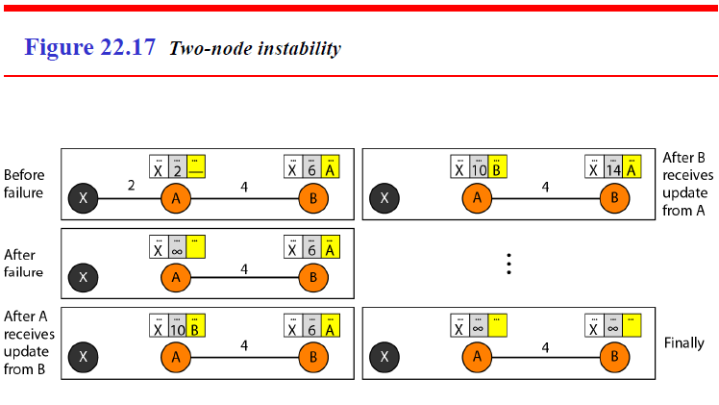
19.<number>

Slide 68
Figure 22.17 shows a system with three nodes.
We have shown only the portions of the routing table needed for our discussion.
At the beginning, both nodes A and B know how to reach node X.
But suddenly, the link between A and X fails. Node A changes its table.
If A can send its table to B immediately, everything is fine.
However, the system becomes unstable if B sends its routing table to A before receiving A's routing table.
Node A receives the update and, assuming that B has found a way to reach X, immediately updates its routing table.
19.<number>

Slide 69
Based on the triggered update strategy, A sends its new update to B.
Now B thinks that something has been changed around A and updates its
routing table.
The cost of reaching X increases gradually until it reaches infinity.
At this moment, both A and B know that X cannot be reached.
However, during this time the system is not stable.
Node A thinks that the route to X is via B; node B thinks that the route to X is via A.
If A receives a packet destined for X, it goes to B and then comes back to A.
Similarly, if B receives a packet destined for X, it goes to A and comes back
to B.
Packets bounce between A and B, creating a two-node loop problem.
A few solutions have been proposed for instability of this kind.

Slide 70
Defining Infinity
The first obvious solution is to redefine infinity to a smaller number, such as 100. For our previous scenario, the system will be stable in less than 20 updates.
As a matter of fact, most implementations of the distance vector protocol define the distance between each node to be I and define 16 as infinity.
However, this means that the distance vector routing cannot be used in large systems.
The size of the network, in each direction, can not exceed 15 hops.

Slide 71
Split Horizon
Another solution is called split horizon. In this strategy, instead of flooding the table through each interface, each node sends only part of its table through each interface.
If, according to its table, node B thinks that the optimum route to reach X is via A, it does not need to advertise this piece of information to A; the information has come from A (A already knows).
Taking information from node A, modifying it, and sending it back to node A creates the confusion.
In our scenario, node B eliminates the last line of its routing table before it sends it to A.
In this case, node A keeps the value of infinity as the distance to X.
Later when node A sends its routing table to B, node B also corrects its routing table.
The system becomes stable after the first update: both node A and B know that X is not reachable.

Slide 72
Split Horizon and Poison Reverse
Using the split horizon strategy has one drawback.
Normally, the distance vector protocol uses a timer, and if there is no news about
a route, the node deletes the route from its table.
When node B in the previous scenario eliminates the route to X from its advertisement to A, node A cannot guess that this is due to the split horizon strategy (the source of information was A) or because B has not received any news about X recently.
The split horizon strategy can be combined with the poison reverse strategy.
Node B can still advertise the value for X, but if the source of information is A, it can replace the distance with infinity as a warning: "Do not use this value; what I know about this route comes from you."

Slide 73
Three-Node Instability
The two-node instability can be avoided by using the split horizon strategy combined with poison reverse.
However, if the instability is between three nodes, stability cannot be guaranteed.
Figure 22.18 shows the scenario.
Suppose, after finding that X is not reachable, node A sends a packet to B and C to
inform them of the situation.
Node B immediately updates its table, but the packet to C is lost in the network and never reaches C.
Node C remains in the dark and still thinks that there is a route to X via A with a distance of 5.
After a while, node C sends to B its routing table, which includes the route to X. Node B is totally fooled here.

Slide 74
  It receives information on the route to X from C, and according to the algorithm, it updates its table, showing the route to X via C with a cost of 8.
  This information has come from C, not from A, so after awhile node B may advertise this route to A.
  Now A is fooled and updates its table to show that A can reach X via B with a cost of 12.
  Of course, the loop continues; now A advertises the route to X to C, with increased cost, but not to B.
  Node C then advertises the route to B with an increased cost. Node B does the same to A.
  And so on. The loop stops when the cost in each node reaches infinity.
19.<number>

Slide 75
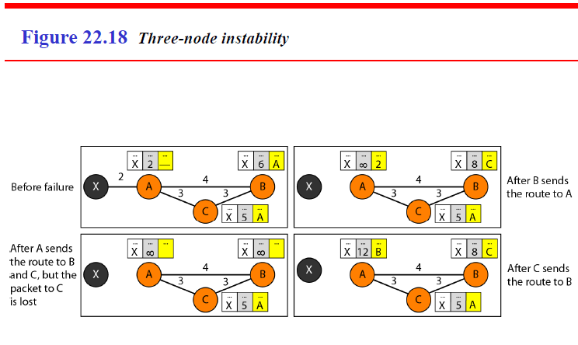
19.<number>

Slide 76
RIP
The Routing Information Protocol (RIP) is an intradomain routing protocol used inside an autonomous system.
It is a very simple protocol based on distance vector routing.
RIP implements distance vector routing directly with some considerations:
1. In an autonomous system, we are dealing with routers and networks (links). The
routers have routing tables; networks do not.
2. The destination in a routing table is a network, which means the first column defines a network address.
3. The metric used by RIP is very simple; the distance is defined as the number of links (networks) to reach the destination. For this reason, the metric in RIP is called
a hop count.
4. Infinity is defined as 16, which means that any route in an autonomous system using
RIP cannot have more than 15 hops.
5. The next-node column defines the address of the router to which the packet is to be
sent to reach its destination.

Slide 77
Figure 22.19 shows an autonomous system with seven networks and four routers.
The table of each router is also shown. Let us look at the routing table for R1.
The table has seven entries to show how to reach each network in the autonomous system.
Router R1 is directly connected to networks 130.10.0.0 and 130.11.0.0, which means that there are no next-hop entries for these two networks.
To send a packet to one of the three networks at the far left, router R1 needs to deliver the packet to R2.
The next-node entry for these three networks is the interface of router R2 with IP address 130.10.0.1.
To send a packet to the two networks at the far right, router R1 needs to send the packet to the interface of router R4 with IP address 130.11.0.1.
The other tables can be explained similarly.
19.<number>

Slide 78
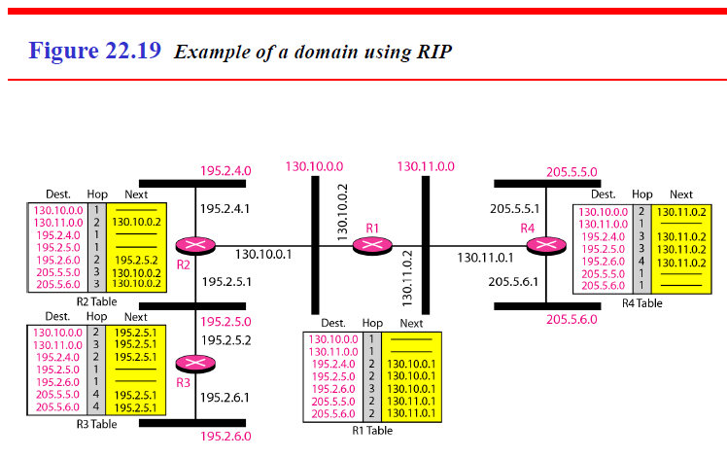
19.<number>

Slide 79
Link State Routing
In link state routing, if each node in the domain has the entire topology of the domain the list of nodes and links, how they are connected including the type, cost (metric), and condition of the links (up or down)-the node can use Dijkstra's algorithm to build a routing table.
Figure 22.20 shows the concept.

Slide 80
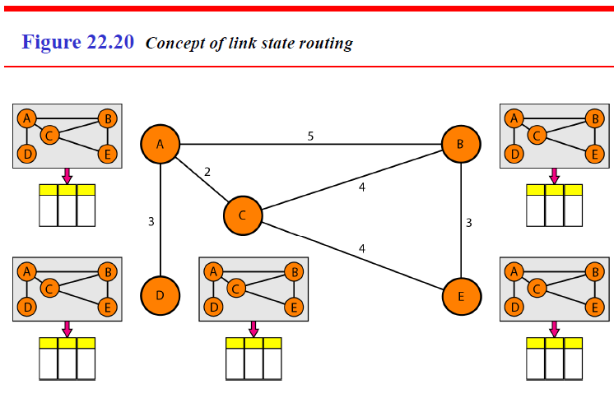
19.<number>

Slide 81
The figure shows a simple domain with five nodes.
Each node uses the same topology to create a routing table, but the routing table for each node is unique because the calculations are based on different interpretations of the topology.
This is analogous to a city map.
While each person may have the same map, each needs to take a different route to reach her specific destination.
19.<number>

Slide 82
The topology must be dynamic, representing the latest state of each node and each link.
If there are changes in any point in the network (a link is down, for example), the topology must be updated for each node.
How can a common topology be dynamic and stored in each node?
No node can know the topology at the beginning or after a change somewhere in the network.
Link state routing is based on the assumption that, although the global knowledge about the topology is not clear, each node has partial knowledge: it knows the state (type, condition, and cost) of its links.
In other words, the whole topology can be compiled from the partial knowledge of each node.
19.<number>

Slide 83
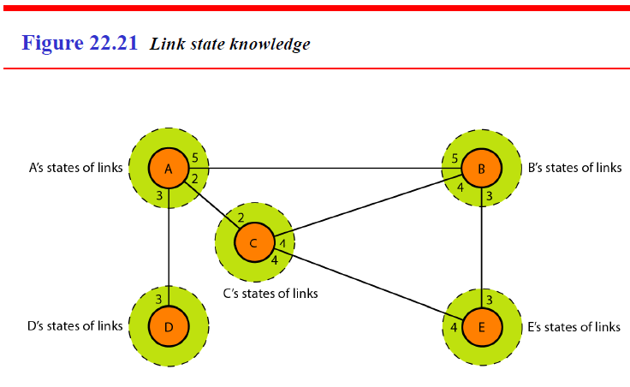
Figure 22.21 shows the same domain as in Figure 22.20, indicating the part of the knowledge belonging to each node.
19.<number>

Slide 84
Node A knows that it is connected to node B with metric 5, to node C with metric 2, and to node D with metric 3.
Node C knows that it is connected to node A with metric 2, to node B with metric 4, and to node E with metric 4.
Node D knows that it is connected only to node A with metric 3. And so on.
Although there is an overlap in the knowledge, the overlap guarantees the creation of a common topology-a picture of the whole domain for each node.
19.<number>

Slide 85
Building Routing Tables
In link state routing, four sets of actions are required to ensure that each node has the routing table showing the least-cost node to every other node.
1. Creation of the states of the links by each node, called the link state packet (LSP).
2. Dissemination of LSPs to every other router, called flooding, in an efficient and reliable way.
3. Formation of a shortest path tree for each node.
4. Calculation of a routing table based on the shortest path tree.

Slide 86
1. Creation of Link State Packet (LSP)
A link state packet can carry a large amount of information.
For the moment, however, we assume that it carries a minimum amount of data: the node identity, the list of links, a sequence number, and age.
The first two, node identity and the list of links, are needed to make the topology.
The third, sequence number, facilitates flooding and distinguishes new LSPs from old ones.
The fourth, age, prevents old LSPs from remaining in the domain for a long time.

Slide 87
LSPs are generated on two occasions:
When there is a change in the topology of the domain. Triggering of LSP dissemination is the main way of quickly informing any node in the domain to update its topology.
2. On a periodic basis. The period in this case is much longer compared to distance vector routing. As a matter of fact, there is no actual need for this type of LSP dissemination.
It is done to ensure that old information is removed from the domain.
The timer set for periodic dissemination is normally in the range of 60 min or 2 h based on the implementation.
A longer period ensures that flooding does not create too much traffic on the network.
19.<number>

Slide 88
2. Flooding of LSPs
After a node has prepared an LSP, it must be disseminated to all other nodes, not only to its neighbors. The process is called flooding and based on the following:
1.The creating node sends a copy of the LSP out of each interface.
2. A node that receives an LSP compares it with the copy it may already have. If the newly arrived LSP is older than the one it has (found by checking the sequence number), it discards the LSP.
If it is newer, the node does the following:
a. It discards the old LSP and keeps the new one.
b. It sends a copy of it out of each interface except the one from which the packet arrived. This guarantees that flooding stops somewhere in the domain (where a node has only one interface).

Slide 89
3. Formation of shortest Path Tree:
Dijkstra Algorithm
After receiving all LSPs, each node will have a copy of the whole topology.
However, the topology is not sufficient to find the shortest path to every other node; a shortest path tree is needed.
A tree is a graph of nodes and links; one node is called the root.
All other nodes can be reached from the root through only one single route.
A shortest path tree is a tree in which the path between the root and every other node is the shortest.
What we need for each node is a shortest path tree with that node as the root.
The Dijkstra algorithm creates a shortest path tree from a graph.
The algorithm divides the nodes into two sets: tentative and permanent. It finds the neighbors of a current node, makes them tentative, examines them, and if they pass the criteria, makes them permanent.

Slide 90
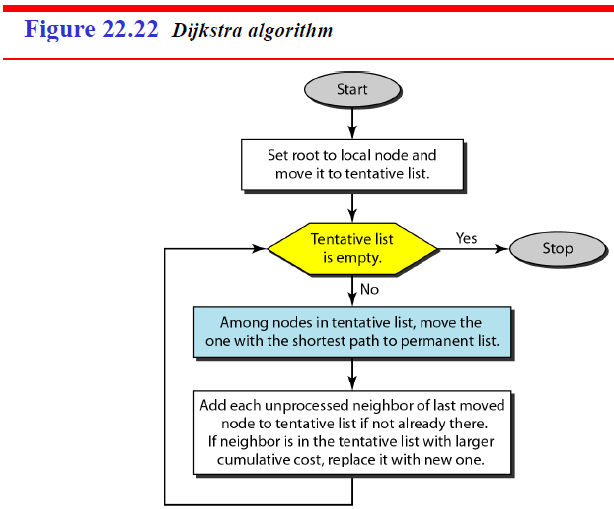
We can informally define the algorithm by using the flowchart
in Figure 22.22.
19.<number>

Slide 91
Let us apply the algorithm to node A of our sample graph in Figure 22.23.
To find the shortest path in each step, we need the cumulative cost from the root to each node, which is shown next to the node.
The following shows the steps.
At the end of each step, we show the permanent (filled circles) and the tentative (open circles) nodes and lists with the cumulative costs.
19.<number>

Slide 92
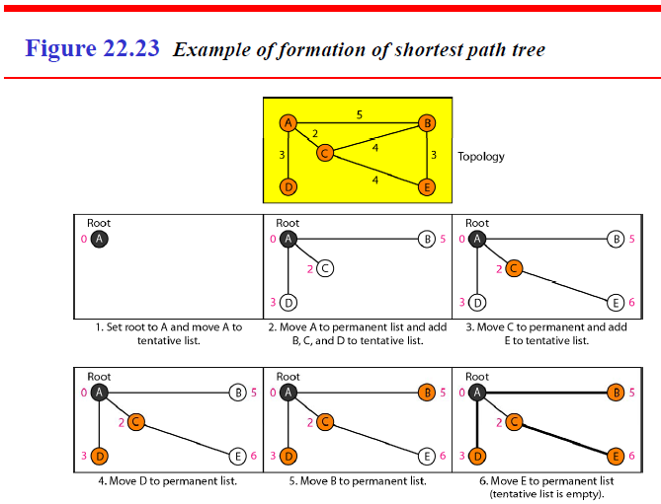
19.<number>

Slide 93
1. We make node A the root of the tree and move it to the tentative list. Our two lists are
Permanent list: empty Tentative list: A(O)
2. Node A has the shortest cumulative cost from all nodes in the tentative list. We move A to the permanent list and add all neighbors of A to the tentative list. Our new lists are
Permanent list: A(O) Tentative list: B(5), C(2), D(3)
3. Node C has the shortest cumulative cost from all nodes in the tentative list. We move C to the permanent list. Node C has three neighbors, but node A is already processed, which makes the unprocessed neighbors just B and E. However, B is already in the tentative list with a cumulative cost of 5. Node A could also reach node B through C with a cumulative cost of 6. Since 5 is less than 6, we keep node B with a cumulative cost of 5 in the tentative list and do not replace it. Our new lists are
Permanent list: A(O), C(2) Tentative list: B(5), D(3), E(6)
19.<number>

Slide 94
4. Node D has the shortest cumulative cost of all the nodes in the tentative list. We move D to the permanent list. Node D has no unprocessed neighbor to be added to the tentative list. Our new lists are
Permanent list: A(O), C(2), D(3) Tentative list: B(5), E(6)
5. Node B has the shortest cumulative cost of all the nodes in the tentative list. We move B to the permanent list. We need to add all unprocessed neighbors of B to the tentative list (this is just node E). However, E(6) is already in the list with a smaller cumulative cost. The cumulative cost to node E, as the neighbor of B, is 8. We keep node E(6) in the tentative list. Our new lists are
Permanent list: A(O), B(5), C(2), D(3) Tentative list: E(6)
6. Node E has the shortest cumulative cost from all nodes in the tentative list. We move E to the permanent list. Node E has no neighbor. Now the tentative list is empty. We stop; our shortest path tree is ready. The final lists are
Permanent list: A(O), B(5), C(2), D(3), E(6) Tentative list: empty
19.<number>

Slide 95
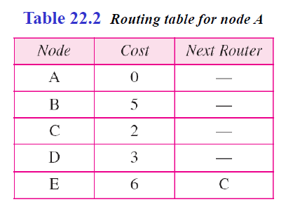
4. Calculation of Routing Table from
Shortest Path Tree
Each node uses the shortest path tree protocol to construct its routing table.
The routing table shows the cost of reaching each node from the root. Table 22.2 shows the routing table for node A.

Slide 96
OSPF
The Open Shortest Path First or OSPF protocol is an intradomain routing protocol based on link state routing. Its domain is also an autonomous system.

Slide 97
Area
To handle routing efficiently and in a timely manner, OSPF divides an autonomous
system into areas.
An area is a collection of networks, hosts, and routers all contained within an autonomous system.
An autonomous system can be divided into many different areas. All networks inside an area must be connected.
Routers inside an area flood the area with routing information.
At the border of an area, special routers called area border routers summarize the information about the area and send it to other areas.

Slide 98
Among the areas inside an autonomous system is a special area called the backbone; all the areas inside an autonomous system must be connected to the backbone.
In other words, the backbone serves as a primary area and the other areas as secondary areas.
This does not mean that the routers within areas cannot be connected to each other, however.
The routers inside the backbone are called the backbone routers. Note that a backbone router can also be an area border router.
If, because of some problem, the connectivity between a backbone and an area is broken, a virtual link between routers must be created by an administrator to allow continuity of the functions of the backbone as the primary area.
19.<number>

Slide 99
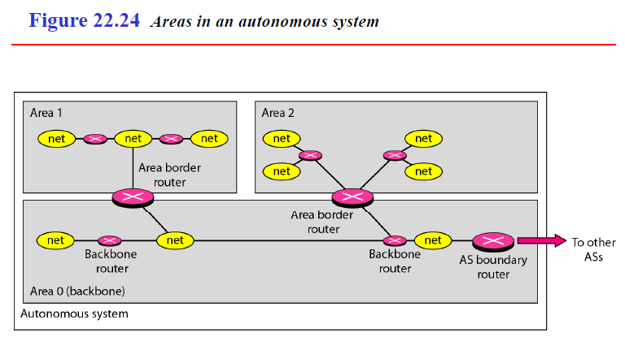
Each area has an area identification. The area identification of the backbone is zero. Figure 22.24 shows an autonomous system and its areas.
19.<number>

Slide 100
Metric
The OSPF protocol allows the administrator to assign a cost, called the metric, to each route.
The metric can be based on a type of service (minimum delay, maximum throughput, and so on).
As a matter of fact, a router can have multiple routing tables, each based on a different type of service.

Slide 101
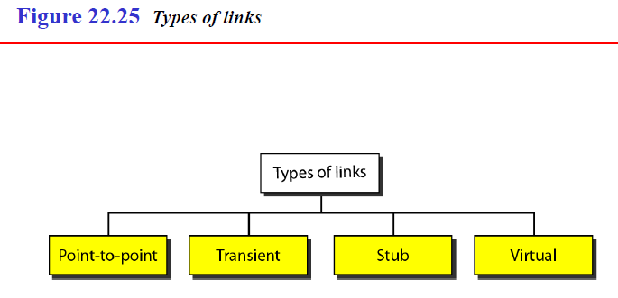
Types of Links
In OSPF terminology, a connection is called a link.
Four types of links have been defined: point-to-point, transient, stub, and virtual (see Figure 22.25).
19.<number>

Slide 102
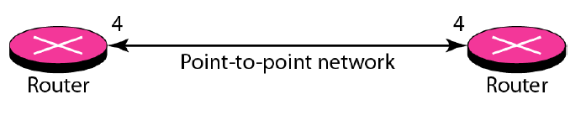
1. point-to-point link
A point-to-point link connects two routers without any other host or router in between.
In other words, the purpose of the link (network) is just to connect the two routers.
An example of this type of link is two routers connected by a telephone line or a T line.
There is no need to assign a network address to this type of link.
Graphically, the routers are represented by nodes, and the link is represented by a bidirectional edge connecting the nodes.
The metrics, which are usually the same, are shown at the two ends, one for each direction.
In other words, each router has only one neighbor at the other side of the link (see Figure 22.26).
19.<number>

Slide 103
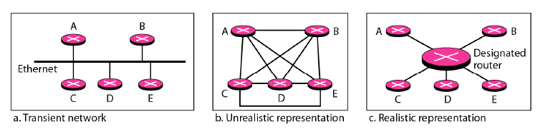
2. Transient link
A transient link is a network with several routers attached to it.
The data can enter through any of the routers and leave through any router.
All LANs and some WANs with two or more routers are of this type. In this case, each router has many neighbors.
For example, consider the Ethernet in Figure 22.27a.
Router A has routers B, C, D, and E as neighbors.
Router B has routers A, C, D, and E as neighbors.
19.<number>

Slide 104
This is neither efficient nor realistic. It is not efficient because each router needs to advertise the neighborhood to four other routers, for a total of 20 advertisements.
It is not realistic because there is no single network (link) between each pair of routers; there is only one network that serves as a crossroad between all five routers.
To show that each router is connected to every other router through one single network, the network itself is represented by a node. However, because a network is not a machine, it cannot function as a router. One of the routers in the network takes this responsibility. It is assigned a dual purpose; it is a true router and a designated router.
We can use the topology shown in Figure 22.27c to show the connections of a transient network.
19.<number>

Slide 105
Now each router has only one neighbor, the designated router (network).
On the other hand, the designated router (the network) has five neighbors.
We see that the number of neighbor announcements is reduced from 20 to 10.
Still, the link is represented as a bidirectional edge between the nodes. However, while there is a metric from each node to the designated router, there is no metric from the designated router to any other node.
The reason is that the designated router represents the network.
We can only assign a cost to a packet that is passing through the network.
We cannot charge for this twice.
When a packet enters a network, we assign a cost; when a packet leaves the network to go to the router, there is no charge.
19.<number>

Slide 106
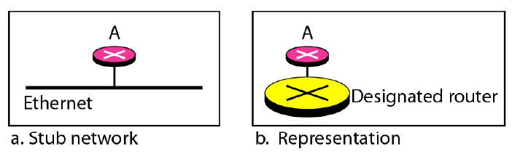
3. Stub Link
A stub link is a network that is connected to only one router.
The data packets enter the network through this single router and leave the network through this same router. This is a special case of the transient network.
We can show this situation using the router as a node and using the designated router for the network.
However, the link is only one-directional, from the router to the network (see Figure 22.28).
19.<number>

Slide 107
When the link between two routers is broken, the administration may create a virtual link between them, using a longer path that probably goes through several routers.
19.<number>

Slide 108
Graphical Representation
Let us now examine how an AS can be represented graphically.
Figure 22.29 shows a small AS with seven networks and six routers.
Two of the networks are point-to-point networks. We use symbols such as N1 and N2 for transient and stub networks. There is no need to assign an identity to a point-to point network.
The figure also shows the graphical representation of the AS as seen by OSPF.
We have used square nodes for the routers and ovals for the networks (represented by designated routers). However, OSPF sees both as nodes. Note that we have three stub networks.
19.<number>

Slide 109
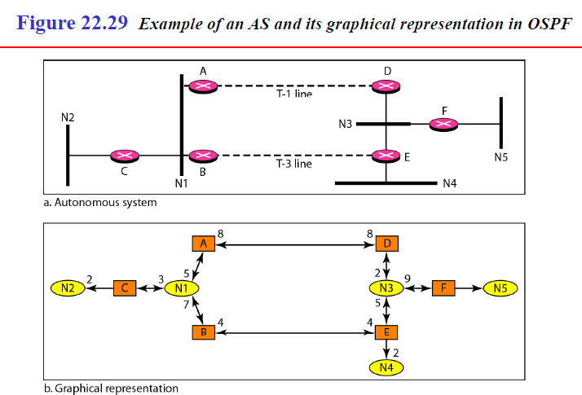
19.<number>

Slide 110
BGP
Border Gateway Protocol (BGP) is an interdomain routing protocol using path vector routing.
It first appeared in 1989 and has gone through four versions.

Slide 111
Types of Autonomous Systems
As we said before, the Internet is divided into hierarchical
domains called autonomous systems.
For example, a large corporation that manages its own network and has full control over it is an autonomous system.
A local ISP that provides services to local customers is an autonomous system.

Slide 112
We can divide autonomous systems into three categories: Stub, multihomed, and transit.
1. Stub AS.
A stub AS has only one connection to another AS.
The interdomain data traffic in a stub AS can be either created or terminated in the AS.
The hosts in the AS can send data traffic to other ASs.
The hosts in the AS can receive data coming from hosts in other ASs.
Data traffic, however, cannot pass through a stub AS.
A stub AS is either a source or a sink.
A good example of a stub AS is a small corporation or a small local ISP.
19.<number>

Slide 113
2.Multihomed AS.
A multihomed AS has more than one connection to other ASs, but it is still only a source or sink for data traffic.
It can receive data traffic from more than one AS. It can send data traffic to more than one AS, but there is no transient traffic.
It does not allow data coming from one AS and going to another AS to pass through.
A good example of a multihomed AS is a large corporation that is connected to more than one regional or national AS that does not allow transient traffic.
3.Transit AS.
A transit AS is a multihomed AS that also allows transient traffic.
Good examples of transit ASs are national and international ISPs (Internet backbones).
19.<number>

Slide 114
Path Attributes
In our previous example, we discussed a path for a destination network.
The path was presented as a list of autonomous systems, but is, in fact, a list of attributes.
Each attribute gives some information about the path.
The list of attributes helps the receiving router make a more-informed decision when applying its policy.

Slide 115
Attributes are divided into two broad categories: well known and optional.
A well-known attribute is one that every BGP router must recognize.
An optional attribute is one that needs not be recognized by every router.
Well-known attributes are themselves divided into two categories: mandatory and discretionary.
A well-known mandatory attribute is one that must appear in the description of a route.
A well-known discretionary attribute is one that must be recognized by each router, but is not required to be included in every update message.
One wellknown mandatory attribute is ORIGIN.
This defines the source of the routing information (RIP, OSPF, and so on).
Another well-known mandatory attribute is AS_PATH.
19.<number>

Slide 116
This defines the list of autonomous systems through which the destination can be reached.
Still another well-known mandatory attribute is NEXT-HOP, which defines the next router to which the data packet should be sent.
The optional attributes can also be subdivided into two categories: transitive and non-transitive.
An optional transitive attribute is one that must be passed to the next router by the router that has not implemented this attribute.
An optional non-transitive attribute is one that must be discarded if the receiving router has not implemented it.
19.<number>

Slide 117
BGP Sessions
The exchange of routing information between two routers using BGP takes place in a session.
A session is a connection that is established between two BGP routers only for the sake of exchanging routing information.
To create a reliable environment, BGP uses the services of TCP. In other words, a session at the BGP level, as an application program, is a connection at the TCP level.
However, there is a subtle difference between a connection in TCP made for BGP and other application programs.
When a TCP connection is created for BGP, it can last for a long time, until something unusual happens.
For this reason, BGP sessions are sometimes referred to as semipennanent
connections

Slide 118
External and Internal BGP
If we want to be precise, BGP can have two types of sessions:
external BGP (E-BGP) and internal BGP (I-BGP) sessions.
The E-BGP session is used to exchange information between two speaker nodes belonging to two different autonomous systems.
The I-BGP session, on the other hand, is used to exchange routing information between two routers inside an autonomous system.
Figure 22.32 shows the idea.
The session established between AS1 and AS2 is an E-BGP session.
The two speaker routers exchange information they know about networks in the Internet.
However, these two routers need to collect information from other routers in the autonomous systems. This is done using I-BGP sessions.

Slide 119
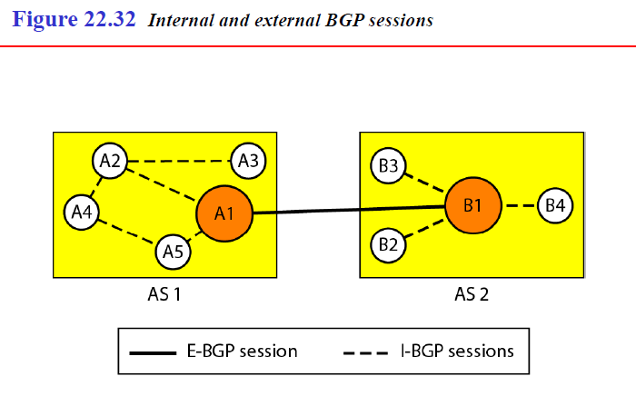
19.<number>

Slide 120
MULTICAST ROUTING PROTOCOLS
Multicasting and Multicast routing protocols.
Multicasting and compare it to Unicasting and Broadcasting.
Applications of multicasting..

Slide 121
Unicast, Multicast, and Broadcast
A message can be unicast, multicast, or broadcast.

Slide 122
Unicasting
In unicast communication, there is one source and one destination.
The relationship between the source and the destination is one-to-one.
In this type of communication, both the source and destination addresses, in the IP datagram, are the unicast addresses assigned to the hosts (or host interfaces, to be more exact).
In Figure 22.33, a unicast packet staI1s from the source S1 and passes through routers to reach the destination D1.
We have shown the networks as a link between the routers to simplify the figure.
Note that in unicasting, when a router receives a packet, it forwards the packet
through only one of its interfaces (the one belonging to the optimum path) as defined in
the routing table.
The router may discard the packet if it cannot find the destination address in its routing table.

Slide 123
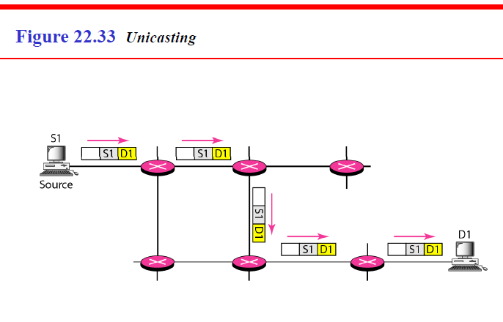
19.<number>

Slide 124
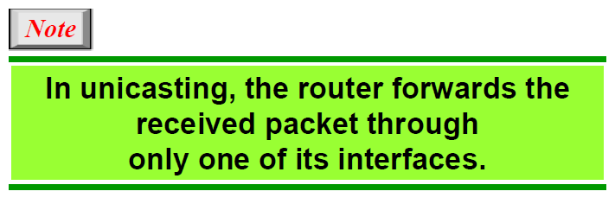
19.<number>

Slide 125
Multicasting
In multicast communication, there is one source and a group of destinations.
The relationship is one-to-many.
In this type of communication, the source address is a unicast address, but the destination address is a group address, which defines one or more destinations.
The group address identifies the members of the group. Figure 22.34 shows the idea behind multicasting.
A multicast packet starts from the source S1 and goes to all destinations that belong to group G1.
In multicasting, when a router receives a packet, it may forward it through several of its interfaces.

Slide 126
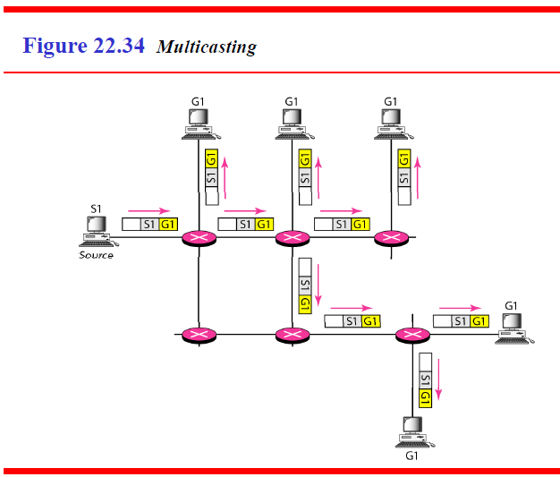
19.<number>

Slide 127
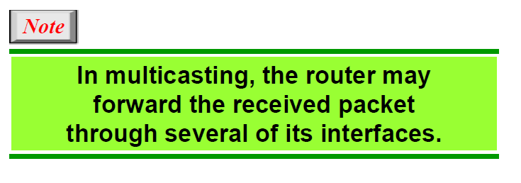
19.<number>

Slide 128
Broadcasting
In broadcast communication, the relationship between the source and the destination is one-to-all.
There is only one source, but all the other hosts are the destinations.
The Internet does not explicitly support broadcasting because of the huge amount of traffic it would create and because of the bandwidth it would need.
Imagine the traffic generated in the Internet if one person wanted to send a message to everyone else connected to the Internet.

Slide 129
Multicasting Versus Multiple Unicasting
Multicasting starts with one single packet from the source that is duplicated by the routers.
The destination address in each packet is the same for all duplicates.
Note that only one single copy of the packet travels between any two routers.

Slide 130
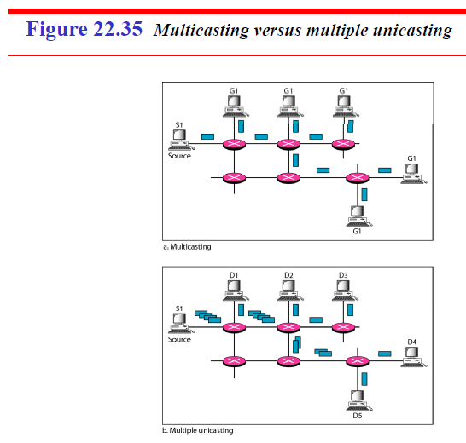
19.<number>

Slide 131
In multiple unicasting, several packets start from the source.
If there are five destinations, for example, the source sends five packets, each with a different unicast destination address.
Note that there may be multiple copies traveling between two routers.
For example, when a person sends an e-mail message to a group of people, this is multiple unicasting.
The e-mail software creates replicas of the message, each with a different destination address and sends them one by one.
This is not multicasting; it is multiple unicasting.
19.<number>

Slide 132
Emulation of Multicasting with Unicasting
You might wonder why we have a separate mechanism for multicasting, when it can be emulated with unicasting. There are two obvious reasons for this.
Multicasting is more efficient than multiple unicasting.
In Figure 22.35, we can see how multicasting requires less bandwidth than does multiple unicasting. In multiple unicasting, some of the links must handle several copies.
2. In multiple unicasting, the packets are created by the source with a relative delay
between packets.
If there are 1000 destinations, the delay between the first and the last packet may be unacceptable. In multicasting, there is no delay because only one packet is created by the source.

Slide 133
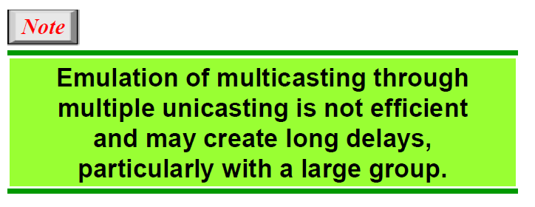
19.<number>

Slide 134
Applications
Multicasting has many applications today such as access to distributed databases,
information dissemination, teleconferencing, and distance learning.
1.Access to Distributed Databases
Most of the large databases today are distributed. That is, the information is stored in
more than one location, usually at the time of production.
The user who needs to access the database does not know the location of the information.
A user's request is multicast to all the database locations, and the location that has the information responds.

Slide 135
2. Information Dissemination
Businesses often need to send information to their customers.
If the nature of the information is the same for each customer, it can be multicast.
In this way a business can send one message that can reach many customers.
For example, a software update can be sent to all purchasers of a particular software package.
19.<number>

Slide 136
Dissemination of News
In a similar manner news can be easily disseminated through multicasting.
One single message can be sent to those interested in a particular topic.
For example, the statistics of the championship high school basketball tournament can be sent to the sports editors of many newspapers.
Teleconferencing
Teleconferencing involves multicasting.
The individuals attending a teleconference all need to receive the same information at the same time.
Temporary or permanent groups can be formed for this purpose.
For example, an engineering group that holds meetings every Monday morning could have a permanent group while the group that plans the holiday party could form a temporary group.
19.<number>

Slide 137
Distance Learning
One growing area in the use of multicasting is distance learning.
Lessons taught by one single professor can be received by a specific group of students.
This is especially convenient for those students who find it difficult to attend classes on campus.
19.<number>

